Slide 1
Differencial gene expression on lung cancer
Gargi Majumdar

Slide 2
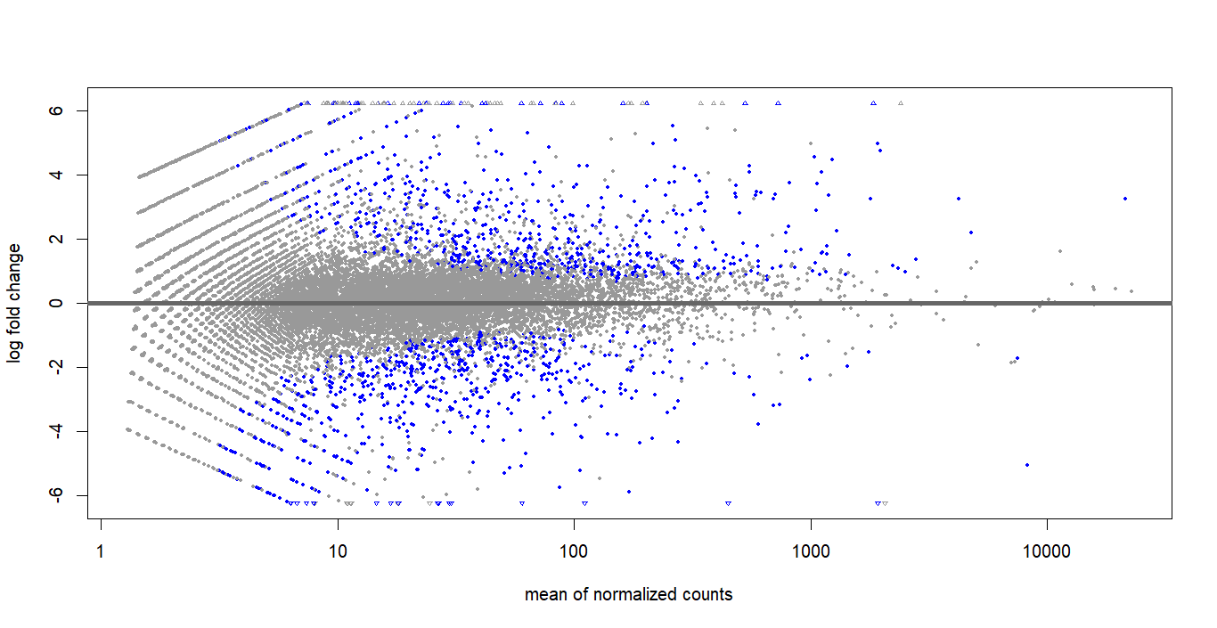
MA plot
Points near the x-axis (M ≈ 0): These genes have similar expression levels in both conditions.
Points above the x-axis (M > 0): These genes are upregulated in the second condition compared to the first.
Points below the x-axis (M < 0): These genes are downregulated in the second condition compared to the first.
Points far from the x-axis (M << 0 or M >> 0): These genes have large differences in expression between the two conditions.
Points far from the y-axis (A >> 0): These genes have high average expression levels in both conditions.

Slide 3
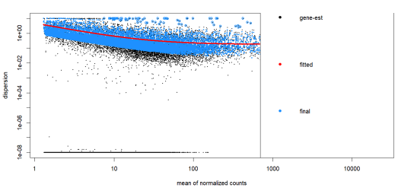
Dispersion plot
Genes on the Red Line: These genes have dispersion values close to what is expected based on their mean expression levels.
Genes Above the Red Line: These genes have higher-than-expected dispersion, indicating that their expression is more variable than expected.
Genes Below the Red Line: These genes have lower-than-expected dispersion, which is less common and might indicate highly stable expression across samples.

Slide 4
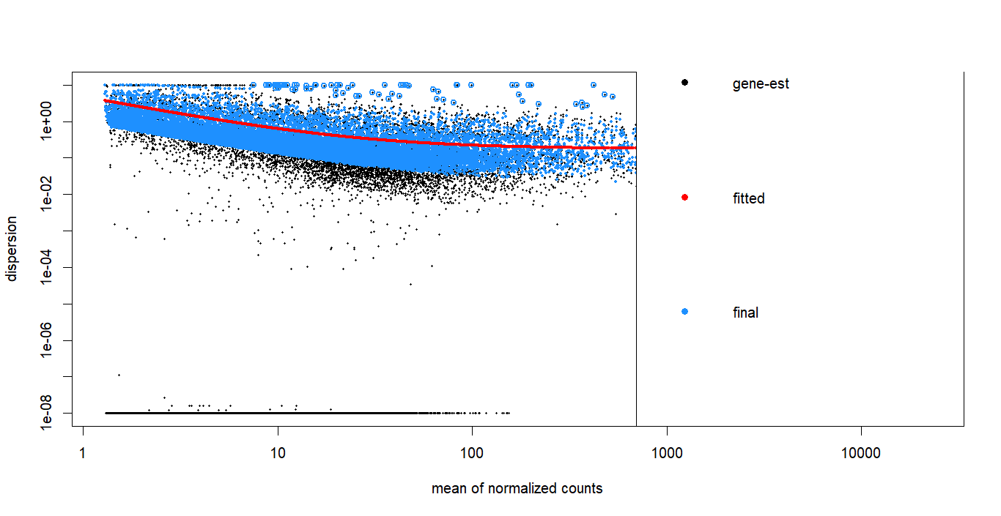

Slide 5
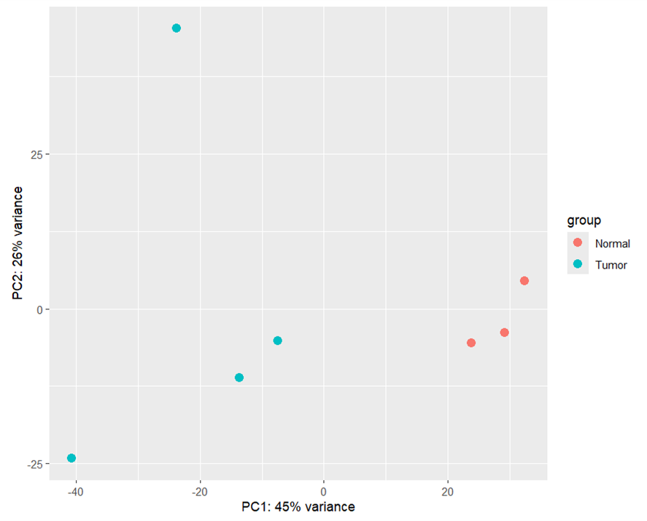
PCA
On the right side Normal sample are appeared.
On the left side Tumor sample are appeared.

Slide 6
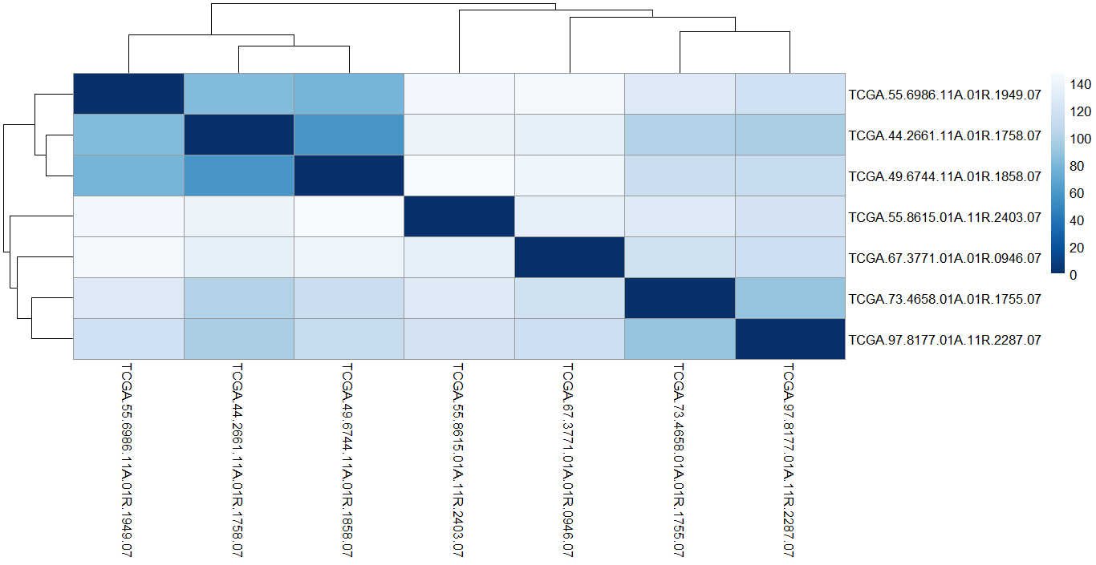
Heatmap
This heatmap gives information about similar and dissimilar the samples are.

Slide 7
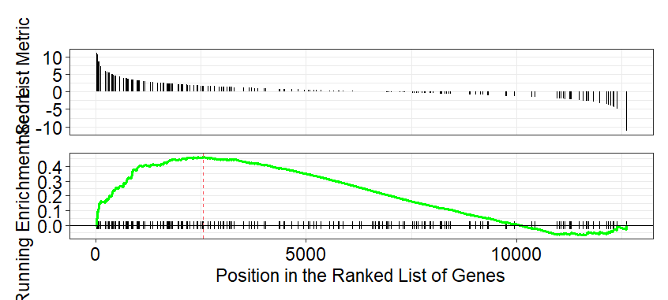
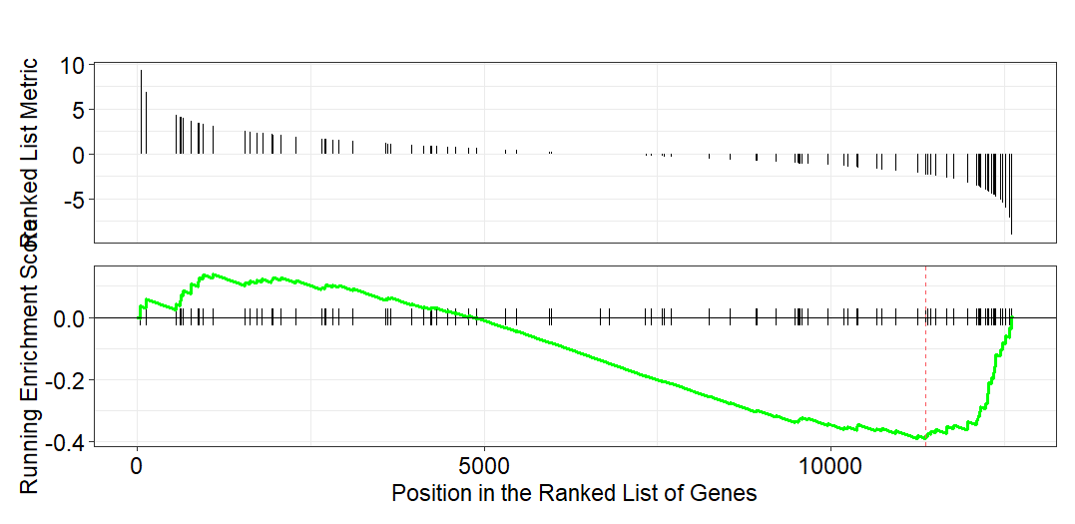
GSEA
ENSG000048839
ENSG0000048839

